Slide 1
Module 7: Lesson 3 NoSQL Database Concepts (Part 2)

Slide 2
Distributing Data Across a Cluster
Let’s image a database table with a single attribute primary key
That is each record has a unique value for some single attribute
For example, let’s consider a product record where each product has a unique stock keeping unit (SKU) number
SKU | ProductName | ProductInStock
123 | Broom | 23
456 | Mop | 54
789 | Bucket | 127

Slide 3

Distributing Data Across a Cluster
Now let’s imagine that we have a 4 node (server or VM) database cluster with each node associate with some storage media
Node 1
Node 2
Node 3
Node 4

Slide 4
Distributing Data Across a Cluster
As the table of products grows very large we won’t be able to store it on one node, so we must distribute records across the cluster
But any strategy to distribute product records must have two characteristics
Record should be evenly distributed across the cluster so no node gets too many records
A specific record must be able to be easily and quickly found without scanning records across all the nodes

Slide 5
Distributing Data Across a Cluster
One way to distribute the records is to use a simple hash function as follows:
h(SKU) = SKU mod 4
This returns the remainder of dividing the SKU number by 4, and is in the range of 0 – 3
So let’s assign each of our 4 nodes a number from 0 – 3 and apply our hash function to distribute records across them
Node 1
(0)
Node 2
(1)
Node 3
(2)
Node 4
(3)

Slide 6
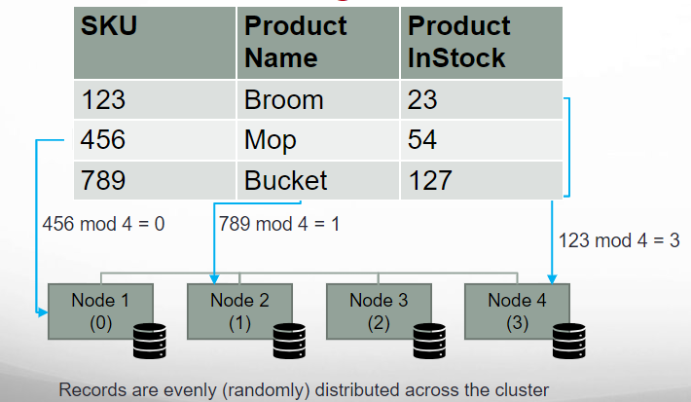
Distributing Data Across a Cluster

Slide 7
Distributing Data Across a Cluster
To look up a record we just need to know its primary key (SKU) and apply our hash function to determine on which node it is stored
For example: Find the record with SKU == 789
789 mod 4 = 1
Node 1
(0)
Node 2
(1)
Node 3
(2)
Node 4
(3)
Records can be found by applying the hash function to determine their node

Slide 8
Distributing Data Across a Cluster
One limitation… to find a record we must always know its primary key (SKU)
If not, we need to scan each node to find the record… very slow
For example… find a record with ProductName of Broom
We did not use the ProductName attribute to calculate the hash… just the SKU
So we must scan multiple nodes to find the record having Broom as its ProductName
Node 1
(0)
Node 2
(1)
Node 3
(2)
Node 4
(3)

Slide 9
Distributing Data Across a Cluster
Another limitation… what if we add a node to our cluster
Now our hash function is SKU mod 5, but this leads to the following situation
The hash value of 2 of the three records changes with the addition of another node
This means with the addition of a node we may need to move many records to other nodes… time consuming
SKU | SKU mod 4 | SKU mod 5 | ProductName | ProductInStock
123 | 3 | 3 | Broom | 23
456 | 0 | 1 | Mop | 54
789 | 1 | 4 | Bucket | 127

Slide 10
Distributing Data Across a Cluster
To avoid this problem we can use a special form of hashing called consistent hashing
Consistent hashing is a special kind of technique such that…
When a cluster is resized, only n/m keys need to be remapped on average
Where n is the number of keys and m is the number of nodes

Slide 11
Distributing Data Across a Cluster
Consistent hashing is based on the following approach…
Instead of assigning each node an index as we did previously
We assign each node a range of indices, from the overall range: 0-1,000,000
And use a hash function which takes a primary key value and outputs an index from 0-1,000,000
And any record whose primary key hashes to one of these ranges is stored into the corresponding node
Node 1
(0)
Node 2
(1)
Node 3
(2)
Node 4
(3)
Node 1
(0 –
250,000)
Node 2
(250,001 – 500,000)
Node 3
(500,001 – 750,000)
Node 4
(500,001-1,000,000)

Slide 12
Distributing Data Across a Cluster
If we add a new node we divide up the index ranges among them
But notice most of the index values on each node remain on that node
For example 200,000 of the 250,000 indices on Node 1 remain on Node 1 when Node 5 is added
So fewer records need to move between nodes when a new node is added
Node 1
(0 –
200,000)
Node 2
(200,001 – 400,000)
Node 3
(400,001 – 600,000)
Node 4
(600,001-800,000)
Node 5
(800,001-1,000,000)

Slide 13
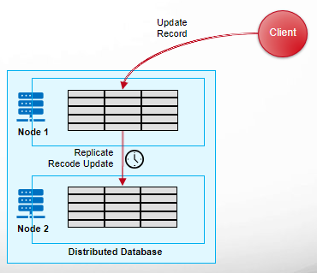
Data Consistency in Distributed Databases
In distributed databases, data replicas are stored across nodes
When one replica is updated via a record delete, insert or update,, that update must be propagated to other replicas
But this update process requires information be transmitted across a network, which means updates cannot happen instantaneously.
There is some period of time between when the update to the first replica happens and that update is reflected in other replicas
As a result, there is some period of time when reading from one replica may not return the same data as reading from another

Slide 14
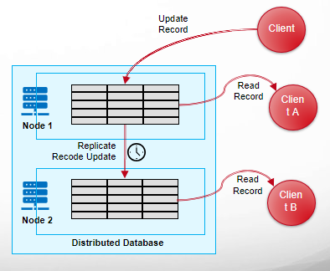
Data Consistency in Distributed Databases
This means that there may be disagreement among database clients as to what the actual state of the database might be
Did client B read the record before or after the record update information propagated to the replica on node 2?
If client B read the record after the update propagated, then client A and client B share a common view of the record (database) state.
But If client B read the record before the update propagated, the client A and client B have differing views of the record (database) state.
Database clients having differing views of database state can lead to random variations in the application of business logic based on updated or stale data

Slide 15
Data Consistency in Distributed Databases
Consistency: A property of distributed databases that make it appear as if all updates are propagated across replicas in real-time or near-real-time, giving clients a uniform view of the database state.
Guarantees of Consistency Models: Distributed systems offer various consistency models with varying degrees of consistency guarantees. .
Strong Consistency: All successful read and write operations appear to have been executed atomically at a single point in time, guaranteeing identical data across all replicas and a consistent view for all clients
Eventual Consistency: Updates are eventually propagated to all replicas, guaranteeing that all nodes will eventually converge to a consistent state. However, reads might return outdated data until updates propagate across the system
Different distributed databases offer different consistency options (strong or eventual consistency) or even allow their users to select a tunable consistency model based on their particular needs

Slide 16



Eventual Consistency A Facebook Example
Bob finds an interesting story and shares with Alice by posting on her Facebook wall
Bob phones Alice, and asks her to check it out
Alice logs in her account, checks her Facebook wall but finds:
- Nothing is there!
?

Slide 17

Eventual Consistency A Facebook Example
Bob tells Alice to wait a bit and check out later
Alice waits for a minute or so and checks back:
- She finds the story Bob shared with her!

Slide 18
Eventual Consistency A Facebook Example
Why Facebook chooses eventual consistent model over the strong consistent one?
Facebook has more than 1 billion active users
It is non-trivial to efficiently and reliably store the huge amount of data generated at any given time
Eventual consistent model offers the option to reduce the load and improve availability

